Slide 1

FIFA World Cup Analytics
Akash Tewari

Slide 2
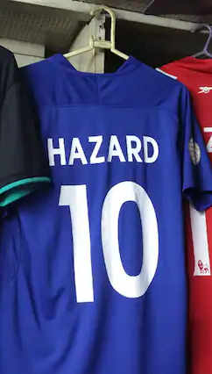
Introduction
Problem Statement
The FIFA World Cup is the world's most prestigious football competition, contested every four years.
The challenge: Identify the key metrics and factors that influence World Cup victories, using datasets that include comprehensive information about all World Cups and match results.
Approach: Conduct in-depth data analysis to extract meaningful insights and patterns that can help understand what contributes to a team's success in the World Cup.
Objective
Analyze historical FIFA World Cup data to uncover key metrics and factors influencing the outcome of the tournament. Highlight the role of data analysts in providing valuable insights to fans worldwide.

Slide 3
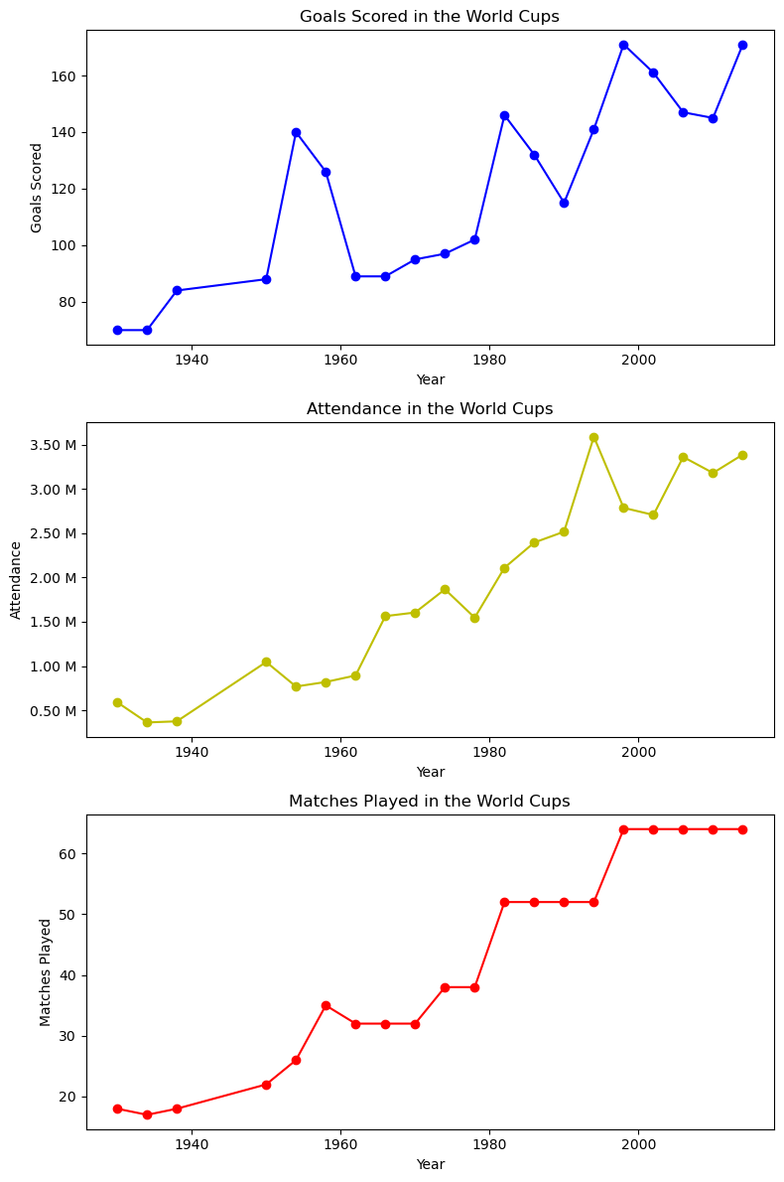
Methodology
A). Data Preparation
Loading Data: Imported and merged World Cup-related datasets in Python for comprehensive analysis.
Exploratory Data Analysis (EDA):
Data Cleaning: Removed inconsistencies, handled missing values, and formatted data for analysis.
Trend Analysis:
Attendance Trends: Examined changes in audience attendance over the years.
Number of Matches: Analyzed the increase or decrease in the number of matches per World Cup.
Goals Scored: Tracked goal-scoring trends across different World Cups.
Winner Analysis:
Identified winning teams and plotted the number of trophies won by each team over the years.

Slide 4
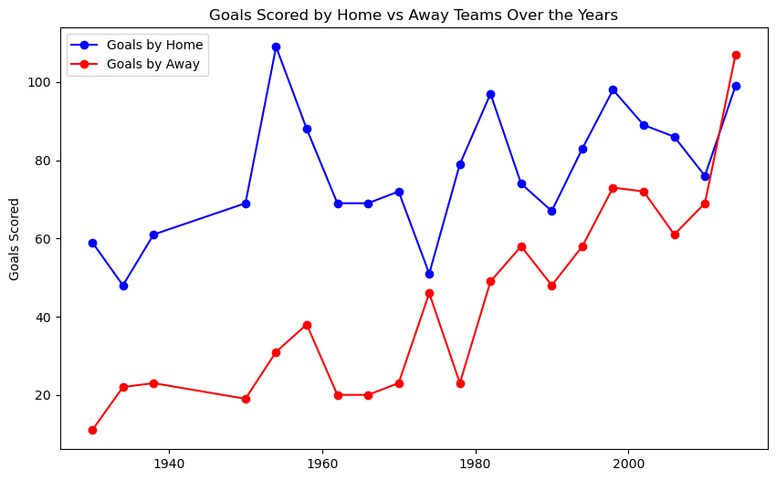
B). KPI Identification
Home vs. Away Team Goals:
Analyzed the trend in goals scored by home and away teams throughout different World Cups.
Top Teams Comparison:
Compared the goals scored by the top 4 teams in each year to determine consistent performers.
C). Advance Analysis
Comeback Situations:
Investigated matches where teams came from behind to win or draw, highlighting significant comeback stories.
Top Performing Players in Knockout Matches:
Identified players who excelled in crucial knockout stages by analyzing goals scored in these high-pressure matches.

Slide 5
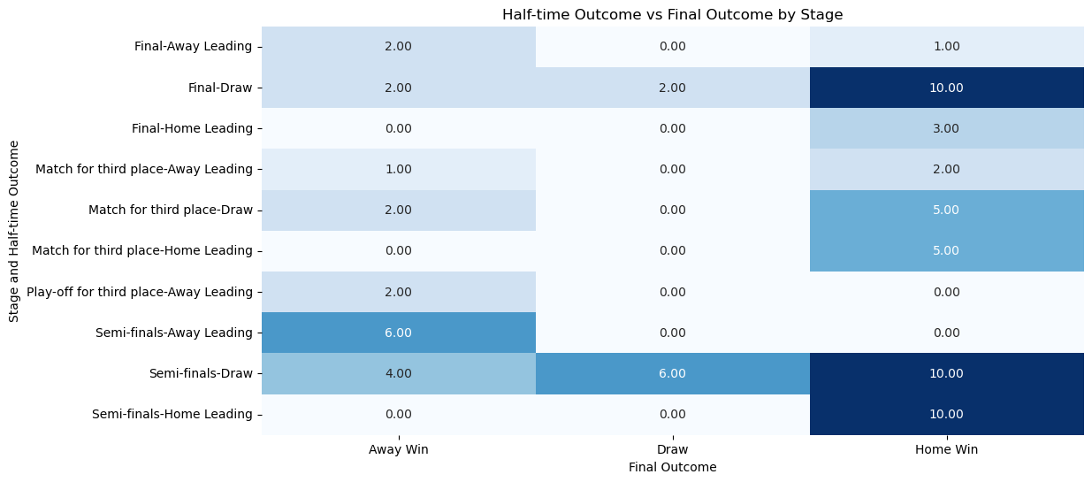
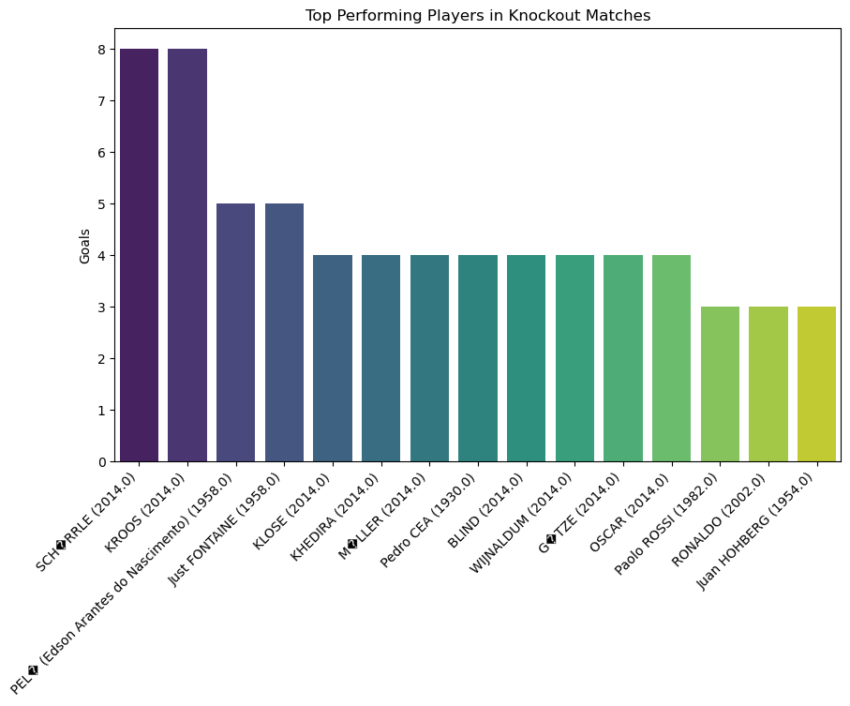
Heat Map showing how many times half time leading team loses creating a great COMEBACK by other team
Column chart showing top players (by goals) in Knockout Matches over the years

Slide 6
Model | Accuracy | Support
Logistic Regression | 0.89 | 169
Random Forest Classifier | 0.99 | 169
Gradient Boosting | 0.95 | 169
D). Winner Prediction
Modelling Techniques:
Applied Logistic Regression, Gradient Boosting, and Random Forest classifiers to predict World Cup winners.
Best Model: Random Forest Classifier showed the highest accuracy in predicting winners.

Slide 7

Power BI Dashboard
General Stats
Visualizations include trends in attendance, matches played, goals scored, a comparison of goals scored by home teams and goals scored by away teams over the years and top teams over the years
Top Players and Teams
Focused on individual player performances, highlighting top goal scorers and top teams based on goals and yellow cards .

Slide 8
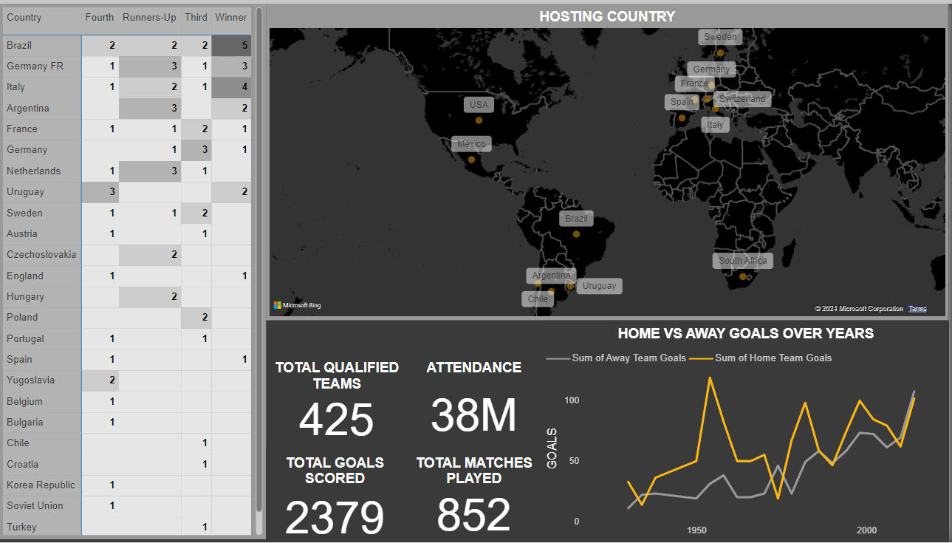

Slide 9
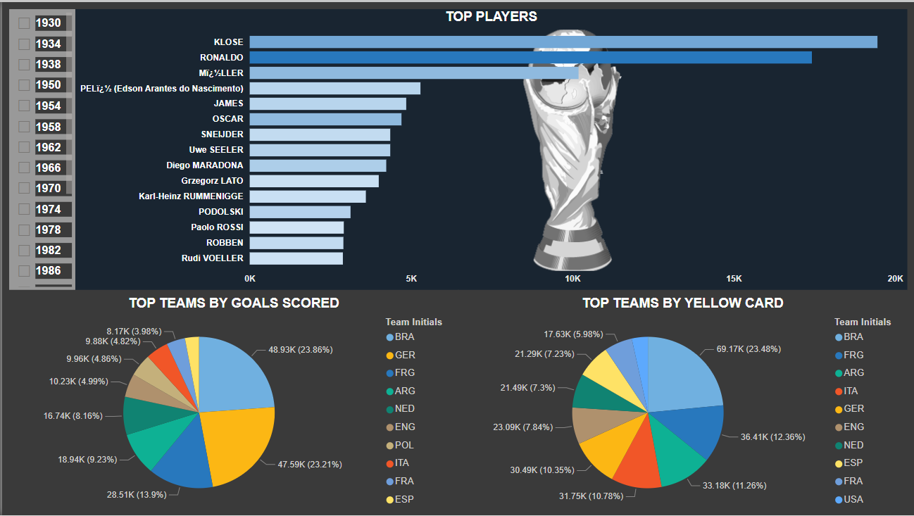

Slide 10
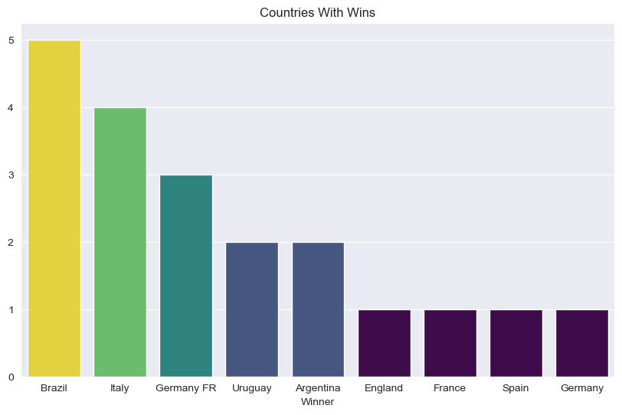
Key Findings
A). Trend Analysis
Attendance: Attendance has generally increased over the years, reflecting growing global interest.
Matches and Goals: Both the number of matches and goals scored have fluctuated, with recent tournaments seeing higher goal tallies.
Consistent Winners: Certain teams, like Brazil, Italy and Germany, consistently perform well, often reaching the final stages.

Slide 11
B). KPI Analysis:
Home Advantage: Home teams tend to score more goals, but away teams have increasingly performed better over the years.
Semi’s Qualifying teams over Years: Fluctuating trend is observed between the goals scored by winners, runners-up, third and fourth finishing team. But in recent years winner teams have outperformed everyone in terms of goals scored i.e. Germany.
C). Advance Analysis:
Comeback Matches: Identified iconic matches where teams overturned significant deficits, underscoring the unpredictability of the knockout stages. Percentage of knockout matches where the half-time leading team wins is only 39.73% and where it was draw is 10.96.
Top Players: Highlighted key players who have consistently performed in knockout stages, making them pivotal to their teams' success. Such as André Schürrle and Toni Kroos with 8 goals each in 2014 knockouts

Slide 12
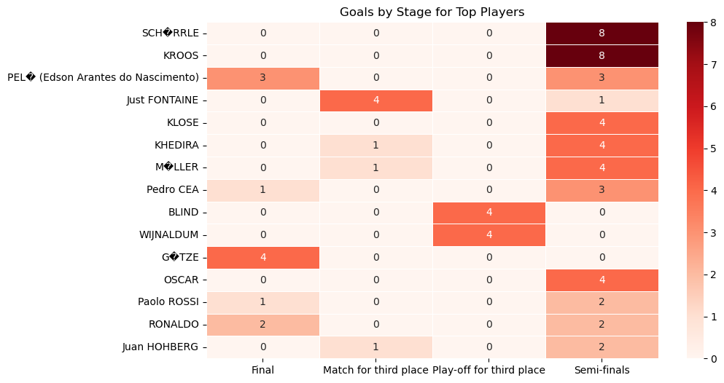
D). Winner Prediction:
Random Forest Classifier: The model provided the most accurate predictions, suggesting it as a reliable tool for future World Cup outcome predictions.
Accuracy Score: Turns out accuracy of our predictive modelling was 0.99% which is not common the possible reason for such high accuracy could be Low value of support i.e. 169 , small dataset etc.

Slide 13

Conclusion
Impact of Data Analysis: The analysis provides valuable insights into the factors influencing World Cup success and demonstrates the power of data in understanding and predicting outcomes in football.
Role of Analysts: The work of data analysts is crucial in uncovering these insights, helping fans and teams alike to better understand the dynamics of the game.

Slide 14

Thank you
Akash Tewari
Unified Mentor

